Slide 1

H.Dip. Sci. – Computer Science 2020
Computer Systems & Networks – Assignment 2
Cathal Henchy
20091405

Slide 2
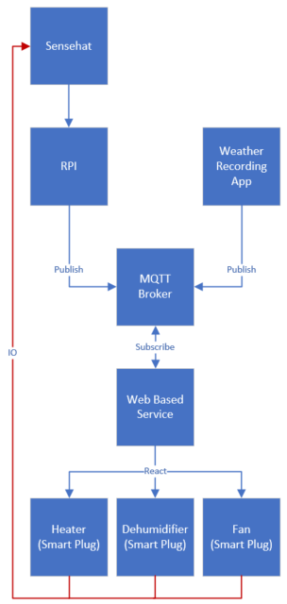
High Level Overview
Using a mounted Sensehat, the Raspberry Pi monitors the temperature and publishes this data to the MQTT Broker (Thingspeak).
A Third Party Web API monitors the local external humidity and also publishes this data to the MQTT Broker.
A Web-based Service (IFTTT) subscribes to the MQTT Broker and based on the data it receives, it may trigger a reaction to one or more of the smart plugs, which will thus power on or power off the corresponding device.
The output due to the action/inaction of each smart plug controlled device will act as the input to the Sensehat mounted Raspberry Pi to continue in this closed loop control cycle.

Slide 3
Hardware/Software used
Hardware
Software
Raspberry Pi
Sensehat
Smart Plug
Thingspeak
IFTTT

Slide 4
Protocols Used
MQTT
HTTP

